Slide 1
ER DIAGRAM FOR
RESEARCHNET
ID 1905107
ID 1905108

Slide 2
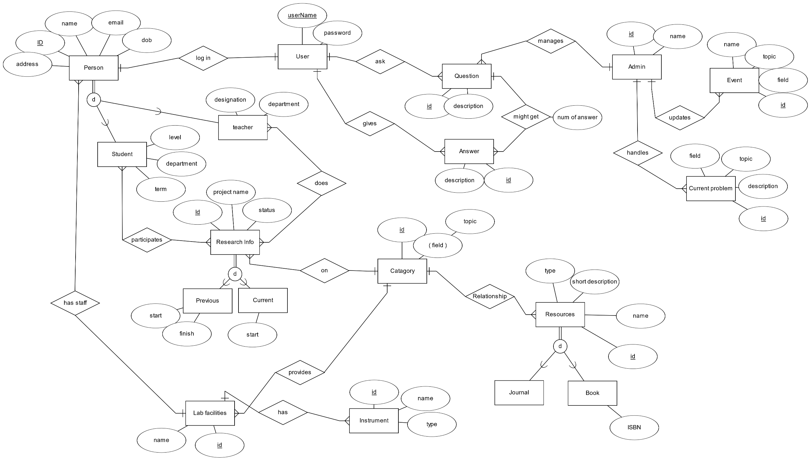
ER DIAGRAM

Slide 3
Schema
Person(Id, Name, Email, Address, Date of Birth,type,type, username, phone)
Student (person_Id, department, level, term)
Teacher(person_Id, department, designation, working_field)
Staff(person_id, working_field, expertise)
Research Info(research_Id, project_Name, description, status, catagory_id)
Previous (research_id, start, finish)
Current(research_id , start)
Category(catagory_id, field, topic)
Task(teacher_id, student_id, research_id, status, description)
Lab facilities (lab_id, name, catagory_id)
Instrument(Instrument_Id, name, type, quantity, lab_id)
Resource(Resource_id, name, short description, type, category_id)
Journal(Resource_id )
Book(Resource_id, ISBN)
Answer (Answer_Id, Description, username, question_id )
Question (Question_Id, Description, username, category_id)
Event(Event_id, Event_Name, Field, Topic, description)
Admin(admin_id, name, person_id)
New project (Problem_id, name, Description, numOfStudent, teacher_id, category_id)
Student request(Problem_id, student_id)

Slide 4
Relational Schema
StudentPerticipate( person_Id , research_id)
TeacherDoesResearch( person_Id, research_Id )
LabHasStaff( Person_id , lab_id)
researchInLab(research_id, lab_id)
staffInvolveInResearch(person_id, research_id, start_time, finish_time)
InstrumentTaken(person_id, instrument_id, research_i status)
To do list-
Kon kon book porlo
Kon kon kaj complete korlo /home page e show
Instruments history table
Question answer table under a project

Slide 5
THANK
YOU

Slide 6
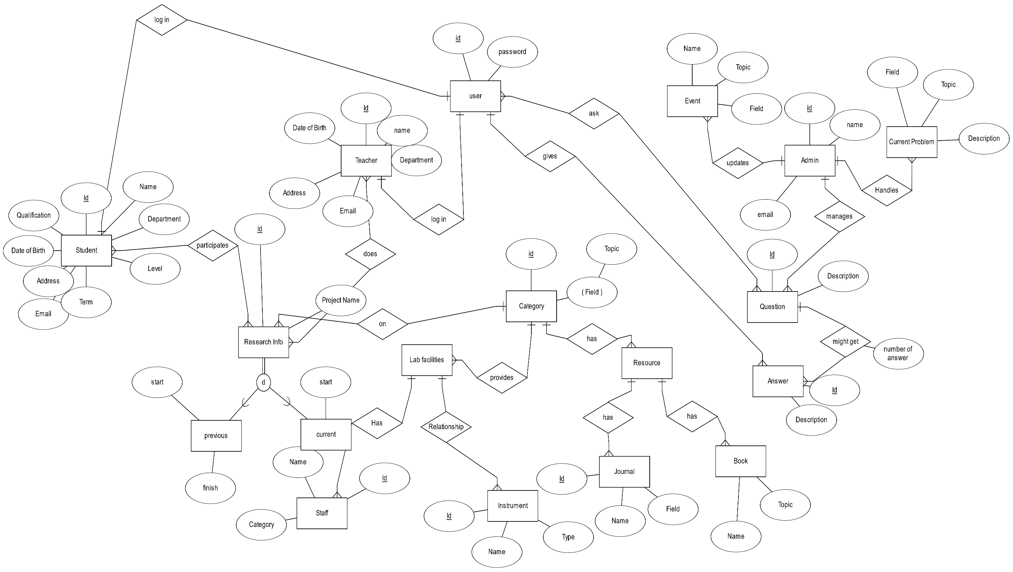
Demo

Slide 7
Demo
Student
User
1.uGrad
2.pGrad
2.Teacher
Admin
User
3.Research info
Previous
Current
4.New research
Minimum student
Teacher
Budget
5.Resource
Book
Journal
Similar project
7.Lab facilities
Staff
Instruments
8.Category
Field
topic
9. Publications
Applied
Accepted
10.Annotations
Where
How many
11.Current problems
Category
12.Q&A
Question
Answer
Number
Multiple answer
13.Research event
Where
When
14.Journal
Id
Name
Field
15.Book
Id
Name
Topic
New entity set
16. task for a research
Ekhane teacher student der task dibe
17.Research er under e teacher-student discussion hobe

Slide 8
Demo
1.STUDENT
Id
Name
Department
Level
Term
Email
Address
Date of birth
Qualification
2.Teacher
Id
Name
Department
Email
Address
Date of birth
3.Category
Field
Topic
4.Research info
Id
Project Name
(Teacher id)
(Student id)
Status
Previous
Start
finish
Current
Start
5.Journal
Id
Name
Field
6.Book
Id
Name
Topic
7.Staff
Id
Name
Category
8.Instrument
Id
Name
type
9.Event
Id
Name
Field
Topic
10.current problem
Field
Topic
Id
Description
Q&A
11.Question
Id
description
12.Answer
Id
description

